Slide 1
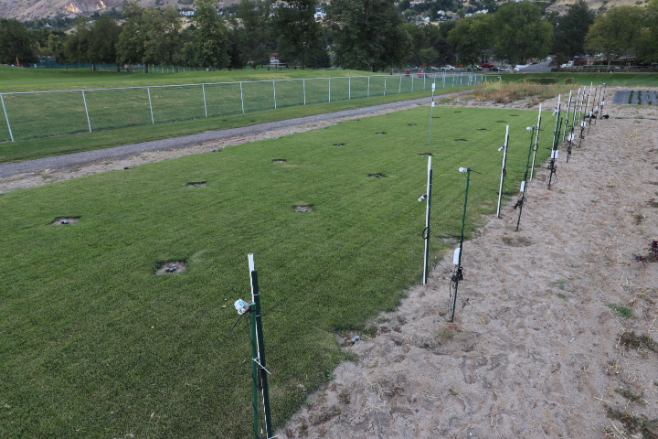
Weather Station
Flowmeters
Sprinkler heads are Hunter MP 1000 Rotators
Dataloggers track soil water sensors
Spectral Radiometers measure canopy temperature
Spectral reflectance sensors measure NDVI.

Slide 2
11z 1
12z3
13z3
21z2
22z3
23z2
31z 1
32z2
33z 1
41z3
42z2
43z 1
EM50G Logger
Radiometer SI-411
SRS NDVI
GS3 Soil Moisture, Temp, EC
MPS 6 Water Potential Sensor
Flow Meter
Atmos 41 Micromet Station
51z2
52z3
53z3
61z 1
62z 1
63z2
71z2
72z 1
73z2
81z2
82z3
83z3
91z3
92z 1
93z 1

Slide 3
11z 1
12z3
13z3
Nitrogen Treatments
Deficient
Optimum
Excessive
Irrigation Treatments
Low (z2)
Full (z 1)
High (Z3)
21z2
22z3
23z2
------- BLOCK 1 -------
31z 1
32z2
33z 1
41z3
42z2
43z 1
51z2
52z3
53z3
------- BLOCK 2 -------
61z 1
62z 1
63z2
71z2
72z 1
73z2
81z2
82z3
83z3
------- BLOCK 3 -------
91z3
92z 1
93z 1

Slide 4
Row 1
Flow Meter: Zone 1
Row 1: Back
Logger ID: 5G106791
Password: tuxy-vowu
Port 1: Zone 1 (center flow meter)
Port 2: Zone 2 (west flow meter)
Port 3: Zone 3 (east flow meter)
Port 4:
Port 5:
Flow Meters
Aerial View
Flow Meter: Zone 1
Flow Meter: Zone 1
Column 1
Column 2
Column 3
Row 1: Front
Logger ID: 5G106794
Password: sech-lotci
Port 1: GS3 11 m 2.5”
Port 2: GS3 8 m 2.5”
Port 3: GS3 2.5”
Port 4: SRS NDVI
Port 5:
GS3 11 m
GS3 8 m
GS3
Row 1
Aerial View
Zone 1
Zone 3
Zone 3

Slide 5
Rows 2 and 3
Column 1
Column 2
Column 3
Row 2
Logger ID: 5G106782
Password: fribu-shoa
Port 1: GS3 11 m 2.5”
Port 2: GS3 8 m 2.5”
Port 3: GS3 2.5”
Port 4: SRS NDVI
Port 5: Apogee SIE-421
GS3 11 m
GS3 8 m
GS3
Row 2
Aerial View
Zone 2
Zone 3
Zone 2
Row 3
Logger ID: 5G106785
Password: keygy-augco
Port 1: GS3 11 m 2.5”
Port 2: GS3 8 m 2.5”
Port 3: GS3 2.5”
Port 4:
Port 5:
GS3 11 m
GS3 8 m
GS3
Row 3
Aerial View
Zone 1
Zone 2
Zone 1
Notes: Apogee SIE-421 has an 18 degree half angle and are installed 1.4 m above ground with a 45 degree angle.

Slide 6
Row 4
Column 1
Column 2
Column 3
Row 4: Front
Logger ID: 5G106781
Password: roha-hygi
Port 1: GS3 11 m 2.5”
Port 2: GS3 8 m 2.5”
Port 3: GS3 2.5”
Port 4: SRS NDVI
Port 5: Apogee SIE-421
GS3 11 m
GS3 8 m
GS3
Row 4
Aerial View
Zone 3
Zone 2
Zone 1
MPS6 2.5”
Row 4: Back
Logger ID: 5G106789
Password: knohi-nidy
Port 1: GS3 6”
Port 2: GS3 12”
Port 3: MPS6 2.5”
Port 4: MPS6 6”
Port 5: MPS6 12”
Row 4
Cross Section
GS3 6”
MPS6 6”
GS3 12”
MPS6 12”
Zone 3
Zone 2
Zone 1
Notes: Apogee SIE-421 has an 18 degree half angle and are installed 1.4 m above ground with a 45 degree angle.

Slide 7
Row 5
EM 60G; Atmos 41
Device Serial No.: 06-00173
Password: opko-vodo
Server: data.decagon.com
Column 1
Column 2
Column 3
Row 5: Front
Logger ID: 5G106792
Password: oded-cijpi
Port 1: GS3 11 m 2.5”
Port 2: GS3 8 m 2.5”
Port 3: GS3 2.5”
Port 4: SRS NDVI
Port 5: Apogee SIE-421
GS3 11 m
GS3 8 m
GS3
Row 5
Aerial View
Zone 2
Zone 3
Zone 3
MPS6 2.5”
Row 5: Back
Logger ID: 5G106788
Password: omvud-tokpa
Port 1: GS3 6”
Port 2: GS3 12”
Port 3: MPS6 2.5”
Port 4: MPS6 6”
Port 5: MPS6 12”
Row 5
Cross Section
GS3 6”
MPS6 6”
GS3 12”
MPS6 12”
Zone 2
Zone 3
Zone 3
Notes: Apogee SIE-421 has an 18 degree half angle and are installed 1.4 m above ground with a 45 degree angle.

Slide 8
Row 6
Column 1
Column 2
Column 3
Row 6: Front
Logger ID: 5G106793
Password: vanya-birfa
Port 1: GS3 11 m 2.5”
Port 2: GS3 8 m 2.5”
Port 3: GS3 2.5”
Port 4: SRS NDVI
Port 5: Apogee SIE-421
GS3 11 m
GS3 8 m
GS3
Row 6
Aerial View
Zone 1
Zone 1
Zone 2
MPS6 2.5”
Row 6: Back
Logger ID: 5G106784
Password: togei-kudu
Port 1: GS3 6”
Port 2: GS3 12”
Port 3: MPS6 12” A
Port 4: MPS6 6”
Port 5: MPS6 12” B
Row 6
Cross Section
GS3 6”
MPS6 12” A
GS3 12”
MPS6 12” B
Zone 1
Zone 1
Zone 2
Notes: Apogee SIE-421 has an 18 degree half angle and are installed 1.4 m above ground with a 45 degree angle.

Slide 9
Rows 7 and 8
Column 1
Column 2
Column 3
Row 7
Logger ID: 5G106790
Password: yahid-owun
Port 1: GS311 m 2.5”
Port 2: GS3 8 m 2.5”
Port 3: GS3 2.5”
Port 4: SRS NDVI
Port 5:
GS3 11 m
GS3 8 m
GS3
Row 7
Aerial View
Zone 2
Zone 1
Zone 2
Row 8
Logger ID: 5G106787
Password: surr-cynyi
Port 1: GS311 m 2.5”
Port 2: GS3 8 m 2.5”
Port 3: GS3 2.5”
Port 4: SRS NDVI
Port 5:
GS3 11 m
GS3 8 m
GS3
Row 8
Aerial View
Zone 2
Zone 3
Zone 3

Slide 10
Row 9
Column 1
Column 2
Column 3
Row 9
Logger ID: 5G106783
Password: jink-royp
Port 1: GS311 m 2.5”
Port 2: GS3 8 m 2.5”
Port 3: GS3 2.5”
Port 4: SRS NDVI
Port 5:
GS3 11 m
GS3 8 m
GS3
Row 9
Aerial View
Zone 3
Zone 1
Zone 1

